Slide 1
The AI of Twistago
Thomas ten Cate
@frozenfractal | frozenfractal.com
Notes:
introduce myself
became an indie game developer about a year ago
going by Frozen Fractal online
if questions: raise hand, feel free to interrupt!

Slide 2
Twistago?!
Notes:
made a game called Twistago
what is Twistago?

Slide 3
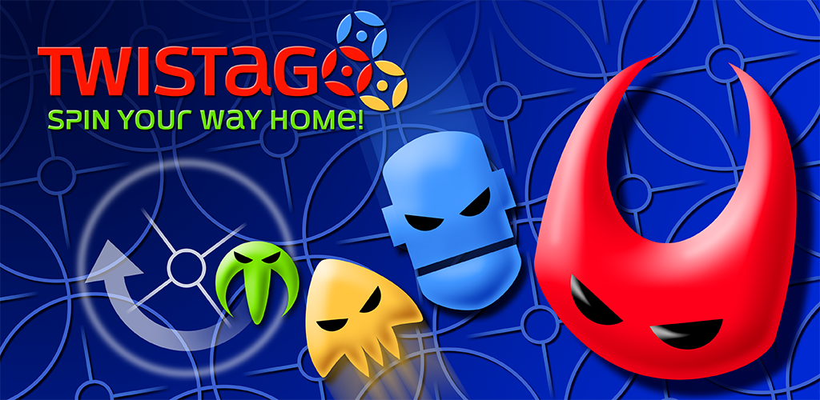


twistago.com | twistago.de
Notes:
Twistago is a tactical board game app
released this summer for Android and iOS
you may have seen it at Show Your Games
also on Spielwies’n in a few weeks
show the launch trailer

Slide 4

Trailer video

Slide 5
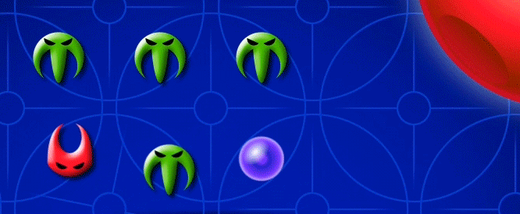
Twistago in a nutshell
A board game for 2-4 players (local humans or computer)
Move your pieces (aliens) home
Novel movement mechanism leads to interesting tactical possibilities
“Black hole” in the centre provides strategic depth
Notes:
online multiplayer postponed until the game proves itself

Slide 6

Origins
Designed by Miroslav Kolar
Board and rules were prototyped and refined over several years
Got attention from a physical board game publisher
Eventually developed into a mobile game by Thomas ten Cate
Miroslav Kolar | grafik-atelier.de

Slide 7
Game rules
Notes:
will now explain the game rules briefly

Slide 8
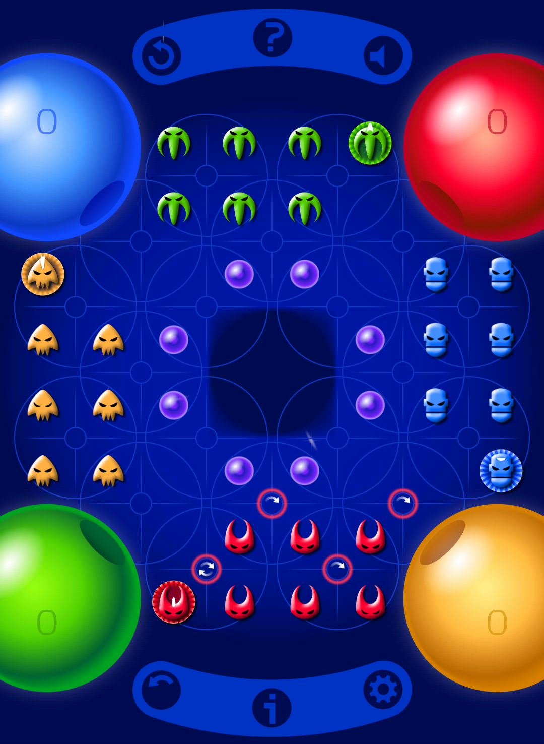
Base rules
Players take turns spinning clockwise 90°
Everything in the same circle moves
Can only spin adjacent to one of your own pieces
Commander may spin twice
Bring aliens to your mothership for 10 points each

Slide 9
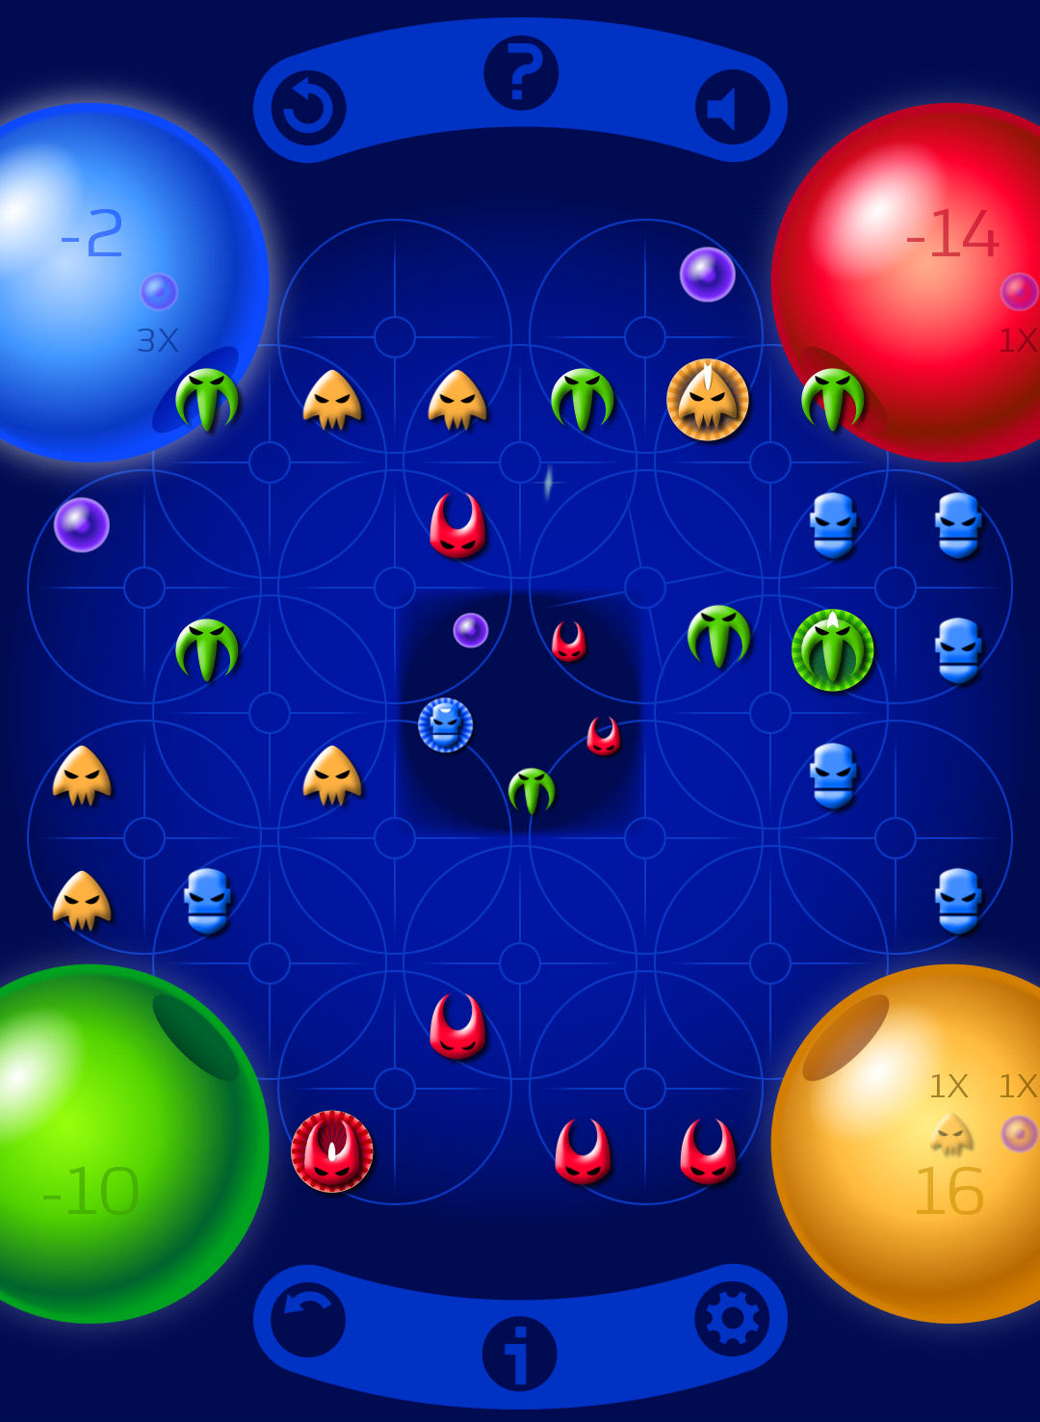
The black hole
Power cores sunk into the black hole become yours, worth 6 points
Aliens sunk into the black hole remain there until freed by paying a power core
Sink opponent’s alien, get free ride home
Aliens stuck in the black hole are worth negative 10 points
Consequence:
The black hole is a shortcut, but risky!

Slide 10
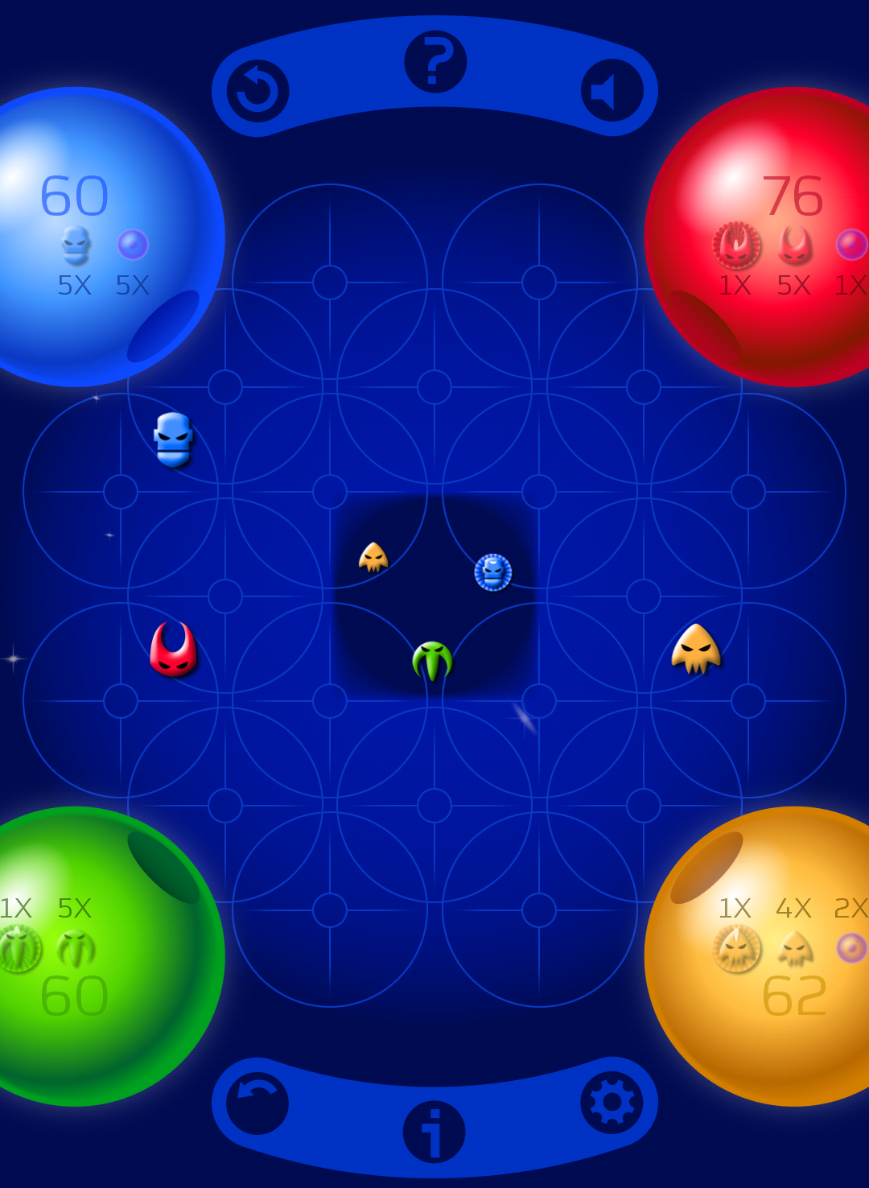
End of the game
Game ends when a player can no longer make any move
The one with the most points wins
But in order to win, your commander must be brought home!
Consequence:
Can be worth ending the game quickly when you’re ahead
Keep an eye on what the other players are aiming for, and adjust your strategy
Notes:
that’s basically all rules
implementing human vs human was easy, how about human vs AIs?

Slide 11
Developing the AI

Slide 12
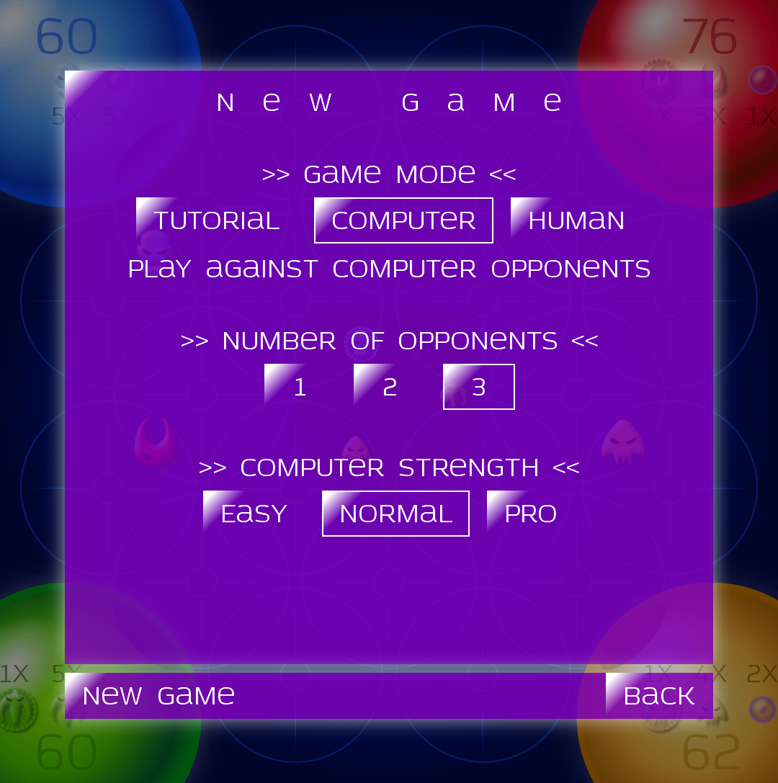
Developing the AI
Three levels of difficulty:
Easy
Normal
Hard (pro)
Developed in this order as well.

Slide 13
Automatic testing
Play many matches against other AIs
Advantages:
Immediate feedback without tedious manual testing
Performance benchmark (“played 100 matches in 15 seconds”)
“Golden master” check to detect accidental changes in behaviour
Fuzz tester, finding and exercising all edge cases
Drawback:
No full substitute for manual tests, silly behaviour goes unnoticed
Tournament finished after 913 ms EasyStrategy: 56 wins (avg: 0 ms, max: 45 ms per move) EasyStrategy: 44 wins (avg: 0 ms, max: 34 ms per move)
Notes:
“silly behaviour goes unnoticed”: if one AI consistently does something stupid, and its opponent does not know how to take advantage, it might look smart from the numbers
let’s go to the main part of the talk: developing easy/medium/hard AIs

Slide 14
The Easy AI

Slide 15
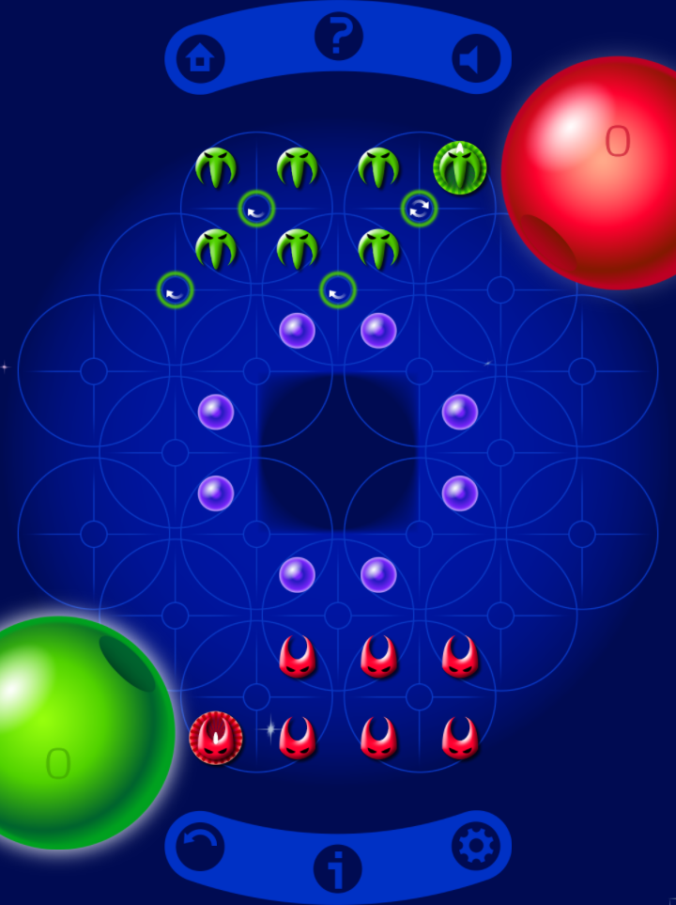


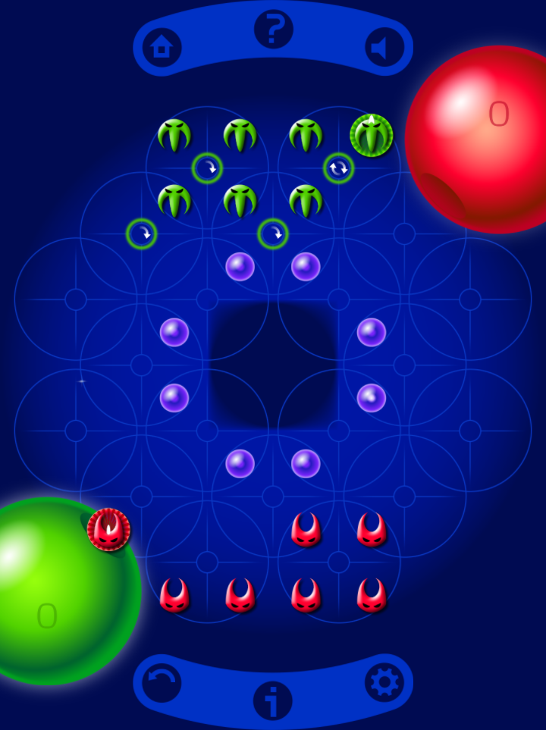
The Easy AI: core idea
Design a value function (or evaluation function): looks at a board position and computes a “value” (number)
Make the move that maximises the value (no looking ahead)
Value: 37
Value: 46
Value: 48
Value: 43
Notes:
suppose it’s the red player’s move, and these are the four possible moves (there are a few more in practice)
for each move, compute the value of the “end state”
pick the move that results in the highest value
simple idea, but how to compute the value? I just made these ones up

Slide 16
The Easy AI: value function
Simplest value function: current score
Notes:
we want to get the highest score, so that makes sense, right?

Slide 17
The Easy AI: value function
Simplest value function: current score
Problem 1: most moves don’t change score immediately
20
20
20

Slide 18
The Easy AI: value function
Simplest value function: current score
Problem 1: most moves don’t change score immediately
Solution: include distance to mothership as well
20
20
20
26
28
23

Slide 19
The Easy AI: value function
Simplest value function: current score
Problem 2: commander must be brought home

Slide 20
The Easy AI: value function
Simplest value function: current score
Problem 2: commander must be brought home
Solution: include commander’s distance to mothership as well, dependent on how far other players are

Slide 21
The Easy AI: value function
Simplest value function: current score
Problem 3: other players’ scores also matter (me gaining 10 points = all others losing 10 points)

Slide 22
The Easy AI: value function
Simplest value function: current score
Problem 3: other players’ scores also matter (me gaining 10 points = all others losing 10 points)
“Solution”: subtract average of other players’ scores

Slide 23
The Easy AI: shortcomings
Does not look ahead
No avoiding dangerous situations
No setting up for opportunities
Does not know how to go through the black hole
This always involves a short-term sacrifice

Slide 24
The Normal AI

Slide 25
The Normal AI: core idea
Keep using a value function, but look ahead multiple moves
We don’t know what the opponent will do, so assume the worst.
Minimax algorithm: minimise maximum loss (= maximise minimum value).
Search the game tree to some fixed depth.
Notes:
so what is a game tree?

Slide 26
The Normal AI: minimax example
9
12
10
26
28
23
35
22
19
Notes:
this is an example game tree, depth 2 (it can get much deeper and wider!)
nodes represent game states
it’s red’s move, they have 3 options
after that it’s green’s move, they also happen to have 3 options in each case (might not be the same ones)
for each node at the bottom, we compute the value for the red player
take a guess: which move should red make?

Slide 27
The Normal AI: minimax example
max
min
9
12
10
26
28
23
35
22
19
Notes:
red is us (the AI player), so we want to pick the maximum score
but green is the opponent, so they want to hinder us, and pick the minimum score
let’s see how it works out; we go from the bottom up

Slide 28
The Normal AI: minimax example
max
9
min
9
12
10
26
28
23
35
22
19

Slide 29
The Normal AI: minimax example
max
9
23
min
9
12
10
26
28
23
35
22
19

Slide 30
The Normal AI: minimax example
max
9
23
19
min
9
12
10
26
28
23
35
22
19
Notes:
now does anyone want to take a guess which move red should make?

Slide 31
The Normal AI: minimax example
23
max
9
23
19
min
9
12
10
26
28
23
35
22
19
Notes:
the worst-case value is written in the top
if in the actual game the opponent does something less than optimal, we may get a higher one
of course, this tiny tree does not represent an actual game

Slide 32
The Normal AI: tree size
Branching factor:
7 pieces, each in 2 circles, plus second move for commander: 18 regular moves
Beaming home an alien after sinking an opponent: 6 aliens to choose from
Possible rescue from black hole at the end of the turn: 8 rescue locations
Worst case: 18 × 6 × 8 = 864
Average: ~13, but cases of 100+ do happen!
Notes:
branching factor: number of outward branches from each node (= number of distinct moves we can make)

Slide 33
The Normal AI: tree depth
Empirically: can evaluate ~10k positions per second (on average mobile device)
Think for 5 seconds: 50k positions

Slide 34
The Normal AI: tree depth
Empirically: can evaluate ~10k positions per second (on average mobile device)
Think for 5 seconds: 50k positions
Tree depth: log(50k) / log(13) = 4.2

Slide 35
The Normal AI: tree depth
Empirically: can evaluate ~10k positions per second (on average mobile device)
Think for 5 seconds: 50k positions
Tree depth: log(50k) / log(13) = 4.2
With 4 players, we just barely consider our second move! What can we do?

Slide 36
The Normal AI: pruning
Standard technique applied to minimax: alpha-beta pruning
max
min
26
28
23
9
12
10
35
22
19
Notes:
let’s look at our example tree again, but I reordered the nodes a bit (does not matter for the outcome)

Slide 37
The Normal AI: pruning
Standard technique applied to minimax: alpha-beta pruning
max
23
min
26
28
23
9
12
10
35
22
19
Notes:
now we know for sure: we can at least get a value of 23
call this value “alpha”

Slide 38
The Normal AI: pruning
Standard technique applied to minimax: alpha-beta pruning
max
23
≤9
min
26
28
23
9
12
10
35
22
19
Notes:
if we choose the middle move, our opponent can bring our value down to 9
9 is less than 23, so no need to look further; this move is certainly worse than what we found already

Slide 39
The Normal AI: pruning
Standard technique applied to minimax: alpha-beta pruning
max
23
≤9
≤22
min
26
28
23
9
12
10
35
22
19
Notes:
similarly, when we see 22 in the right branch, we can also abort
we could skip 3 out of 9 nodes here, but keep in mind that in a real tree, these are large subtrees that we skip

Slide 40
The Normal AI: pruning
Standard technique applied to minimax: alpha-beta pruning
Move ordering becomes relevant. Simplest: sort moves by value function.
Outcome is exactly the same as with minimax, but best-case tree depth doubles.
Notes:
move ordering is relevant because if we check our best moves first (even if we don’t know they’re the best ones), we can better detect bad moves
best-case tree depth doubles: now 8 instead of 4 (if move ordering is good)

Slide 41
The Normal AI: more pruning
Problem: situations with 100+ branching factor take too long, 50+ seconds!
“Solution”: sort moves by descending value function, and consider only the top-N
Notes:
really blunt instrument, but fairly effective
these high-branching cases always involve a rescue, and most rescues are easily seen to be stupid (on the wrong side of the black hole)

Slide 42
The Normal AI: multiple opponents
With two players: zero-sum game (my win is your loss and vice versa).
my_value = –your_value
With more than two players: much harder!
It is not clear whom you should help or hinder.
Players can form alliances.
Players who cannot win can still influence the game’s outcome (kingmaking).

Slide 43
The Normal AI: multiple opponents
Solution 1: use same value function, assume everyone else tries to minimise it
Paranoid! Assumes that everyone is in an alliance against me.
Results in rather defensive play.
Makes any kind of cooperation or alliance-forming impossible.

Slide 44
The Normal AI: multiple opponents
Solution 2: max^{n} algorithm [1], each player has their own value function
Has to make assumptions about what the other players want.
Alpha-beta pruning no longer works. Less tree depth when we need it more!
[1] Luckhardt and Irani, 1986, “An algorithmic solution of n-person games” (PDF)

Slide 45
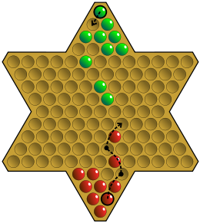
The Normal AI: multiple opponents
Paranoid is better than max^{n} in Chinese Checkers (Stern-Halma) [1].
“These results show that the paranoid algorithm is winning in Chinese Checkers both because it can search deeper, and because its analysis produces better play. We would expect similar results for similar board games.”
[1] Nathan Sturtevant, “A Comparison of Algorithms for Multi-Player Games” (PDF)

Slide 46
The Normal AI: shortcomings
No global idea of where we are in the game (beginning, middle, end)
Does not use the full thinking time
Notes:
so let’s try to fix these, in...

Slide 47
The Hard AI

Slide 48
The Hard AI: core idea
Problem: Normal AI does not care about game phases
A human plays differently depending on where we are in the game:
Early phase: don’t worry about getting home, just collect power cores (important to have these later on)
Middle phase: don’t worry about actually landing, just move towards home (unlanded ships can help each other)
Late phase: land as many aliens as possible, preferring the commander (gather all the points)

Slide 49
The Hard AI: core idea
Problem: Normal AI does not care about game phases
Solution: a “phase-dependent” value function
Determine which phase we are in (from locations of pieces): early, middle, late
Use different value function depending on the current phase

Slide 50
The Hard AI: tuning parameters
Problem: too many parameters to tweak by hand
There are now about 20, for example:
What’s the value of reducing distance to home in the early phase?
How many remaining power cores before switching to middle phase?
What’s the value of a landed piece in the late phase?
…
Many of these are interrelated, so cannot be tweaked one by one.

Slide 51
The Hard AI: tuning parameters
Problem: too many parameters to tweak by hand
Notes:
so what do we do?
automate it!
how do we automate it?

Slide 52
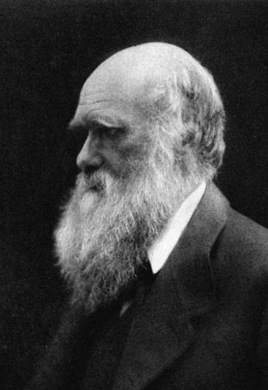
The Hard AI: tuning parameters
Problem: too many parameters to tweak by hand
Solution: genetic algorithm!
Survival of the fittest: losers get eliminated
Cross-breeding: winners reproduce and pass on their genes
Notes:
genetic algorithm, in other words, evolution
how do we do that inside a computer?
what I’m about to describe is just one way of doing it, there are many variations (as in nature)

Slide 53
The Hard AI: genetic algorithm
An individual is just a list of parameter values (genes):
A gene pool consists of a fixed number of individuals (say, 100):
4.3
7.1
–2.4
0.3
0.8
0.7
1.7
–9.0
2.8
1.3
0.9
0.1
0.0
2.5
1.2
1.1
–0.9
–0.1
7.6
9.4
4.3
7.1
–2.4
0.3
0.8
0.7
1.7
–9.0
2.8
1.3
0.9
0.1
0.0
2.5
1.2
1.1
–0.9
–0.1
7.6
9.4
2.8
7.4
0.1
0.2
4.8
0.7
1.9
–6.3
2.3
1.4
3.2
0.3
0.1
2.1
0.9
1.3
–1.0
0.2
7.4
8.7
–0.2
6.2
–1.6
0.6
–2.3
0.6
1.8
–9.8
2.9
1.3
0.6
0.2
–0.2
1.7
1.0
1.4
–1.3
–0.0
7.6
7.2

Slide 54
The Hard AI: genetic algorithm
Algorithm:
Let each individual in the current gene pool play against all others.
Sort by how often they win.
Kill off frequent losers.
Cross-breed remaining winners to refill the gene pool.
Repeat until play strength is good enough.

Slide 55
The Hard AI: the next generation
75 wins
75 wins
73 wins
73 wins
remove losers
breed winners
43 wins
43 wins
42 wins
38 wins
5 wins

Slide 56
The Hard AI: breeding
Breeding mimics sexual reproduction: two individuals produce one offspring.
Randomly pick two parent individuals from the pool
Randomly copy each gene from either parent
Randomly apply some mutations
4.3
7.1
–2.4
0.3
0.8
0.7
1.7
–9.0
2.8
1.3
0.9
0.1
0.0
2.5
1.2
1.1
–0.9
–0.1
7.6
9.4
2.8
7.4
0.1
0.2
4.8
0.7
1.9
–6.3
2.3
1.4
3.2
0.3
0.1
2.1
0.9
1.3
–1.0
0.2
7.4
8.7
4.3
7.1
0.1
0.3
4.8
0.7
2.6
–9.0
2.8
1.3
3.2
–0.2
0.1
2.5
0.9
1.3
–0.9
0.2
7.6
8.7
Notes:
then the final step: repeat until happy

Slide 57
The Hard AI: genetic algorithm
Evolution is slow…
Intel i7 quad-core (with hyperthreading) at 2.67 GHz
8 threads, all cores maxed out at 100%
Took over 20 hours
Could watch live, and tweak evolution parameters like mutation rate on the fly
But eventually, 150 generations later…

Slide 58
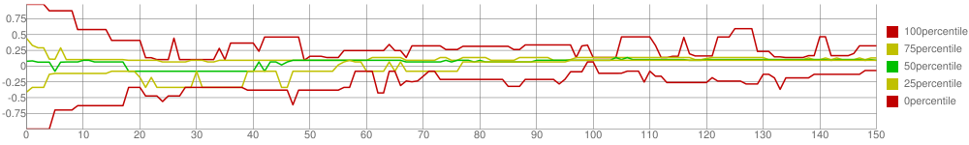
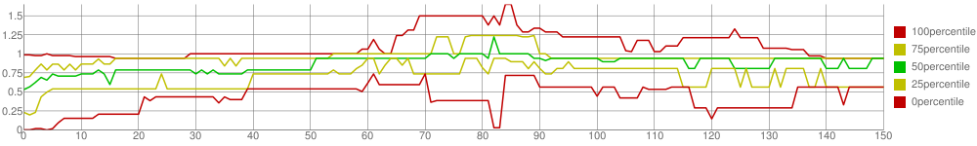
The Hard AI: results
Not all parameters equally important. This one matters:
This one not so much:
Notes:
each generation dumped to a JSON file
made a JavaScript console using the Google Charts API to read these files and draw charts

Slide 59
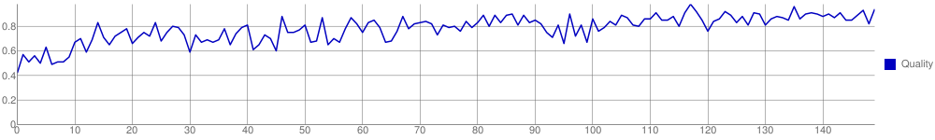
The Hard AI: results
Have the “best” individual of each generation play 100 games against the Normal AI:
Shows a win rate of over 90% against Normal. Victory?
No, humans are still beating it.
Notes:
it is clearly better, but not good enough
so what else can we do?

Slide 60
The Hard AI: tree depth
Problem: it almost never uses the full 5 seconds of thinking time
It’s hard to predict how long a particular search will take (depends on strongly variable branching factor)
If it takes too long and we have to abort, we pick the best fully evaluated move (which may be terrible)
To almost always finish on time, we have to be conservative with search depth

Slide 61
The Hard AI: iterative deepening
Solution: iterative deepening
Search to depth 1, store the best move
If there is still time, search to depth 2, store the best move
If there is still time, search to depth 3, store the best move
…
When out of time, abort the current search, use the last stored move
Near the end (low branching factor), search depth can get as high as 20!

Slide 62
The Hard AI: iterative deepening
Problem: this is wasteful; previous searches used up time, did not contribute value

Slide 63
The Hard AI: iterative deepening
Problem: this is wasteful; previous searches used up time, did not contribute value
But how bad is this?
Remember: branching factor ~13
Each subsequent search takes 13 times as long as the previous one
Wasted time: less than 8% 1 – 1 / (1 + 13^{–1} + 13^{–2} + …)
I can live with that.
Opportunity: use these results for better move ordering in the next search.
Notes:
so how did this work out?

Slide 64
The Hard AI: iterative deepening
Result: top players report that they can no longer beat the Hard AI!
After a bit of practice, they get to about 50% win rate.
My work here is done.

Slide 65
Epilogue

Slide 66
Further reading
My blog frozenfractal.com/blog
Twistago AI, part 1: Easy
Twistago AI, part 2: Normal
Twistago AI, part 3: Hard
Chess Programming Wiki chessprogramming.wikispaces.com
Reddit thread on handling more than 2 players tinyurl.com/multiplayer-board-game-ai

Slide 67
Bonus material
Bitboards in C++
Discriminating other players
Neural networks
Monte Carlo tree search

Slide 68
Bitboards in C++
Tried rewriting the game logic in high-performance C++ using bitboards.
Board is 8×8 = 64; use 64-bits integer (actually std::bitset) to represent locations for each type of piece.
Moves become a sequence of bit masks and shifts, really fast.
Checking whether a square is occupied becomes a bit test, really fast.
Iterating over all pieces becomes slower.
Net result: performance almost the same as manually optimised, but still readable Java.
Back

Slide 69




Discriminating other players
Someone just ahead of me: hinder them so we can overtake!
Someone close behind me: hinder them to keep them there?
Someone far behind me: stop caring? What if they catch up?
Someone far ahead of me: stop caring? What if we want to overtake them?
Back

Slide 70
Neural network: core idea
Genetic algorithm lets us evolve the parameters inside the value function
However, it cannot change the “shape” of the function
Still relies on my human brain to put in factors that might be important
Can we “evolve” the value function itself?

Slide 71
Neural network: core idea
Express the value function as a neural network
In a nutshell:
Numbers go in (board position)
???
Profit! Number comes out (position’s value)
input
hidden
hidden
output
42
Notes:
inputs are numbers (we need to express the board position as an array of numbers)
circles represent “neurons”
each of these arrows is a connection between neurons
each arrow has a weight (amount by which it passes on its value)
neurons add all values, pass them through a transfer function, and produce an output
I wrote question marks because the neural net is like a black box: there’s just a huge pile of numbers inside, and you cannot inspect how it really works

Slide 72
Neural network: training
Algorithms exist for supervised learning: given the input, you know the output
Train a neural net to learn my value function, as a starting point
Got within 4% of the real thing
Making it better requires unsupervised learning: we don’t know the desired output
Here we can use the genetic algorithm again
Genes now represent neuron weights
But there are hundreds of them, instead of 20

Slide 73
Neural networks: why it didn’t work for me
Problems with neural networks:
Many decisions to make
Conversion of board position to input numbers
Shape of the network
Number of layers
Number of neurons in each layer
Plus the parameters of the genetic algorithm (generation size, mutation rate, …)
It’s a black box: the computations can be made visible, but are meaningless
If it doesn’t perform well, it’s really hard to find out why!
Abandoned this approach because it would take too long to get right
Back

Slide 74
Monte Carlo tree search: core idea
MCTS: used by the strongest Go AIs (e.g. Google’s AlphaGo)
For each possible move, play a large number of games until the end, completely at random (Monte Carlo town is home to a famous casino)
Pick the move that wins most often
23%
25%
19%

Slide 75
Monte Carlo tree search: exploration vs. exploitation
“Pure” MCTS wastes a lot of time on moves almost certain to be bad
Balance exploration (trying “bad” moves) against exploitation (trying “good” moves)
UCT formula: put more time into moves that seem good, without entirely ignoring apparently bad ones (they might just look bad due to bad luck)
23%
25%
19%

Slide 76
Monte Carlo tree search: why it didn’t work for me
A game of Twistago is around 200 moves (2 players)
At ~10k positions per second, we can play out ~50 games per second
With 5 seconds of thinking time, we get only 250 data points
Due to the amount of randomness involved, this is not nearly enough
Back

